Slide 1

The Artificial Intelligence Revolution Pierre-Alexandre Balland
Utrecht University
AI Toulouse Institute

Slide 2



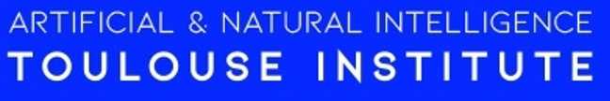
Research + teaching on complex systems, the future of cities, AI and blockchain
Notes:
So my first mission is to learn about the world, and I have started my career in France, then UCLA/MIT, Utrecht and now I am actually in France were president Macron launched in Toulouse (airbus) an AI center as part of his AI strat

Slide 3

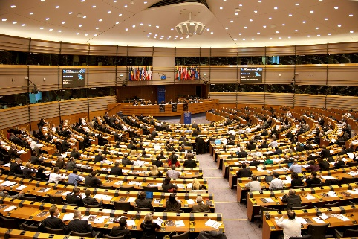
Research + teaching on complex systems, the future of cities, AI and blockchain
Research & Innovation policy
Notes:
- Advise on inoov policy (100 + 220 billion) + this year a lot on resilience GVC, covid 19 stimulus packages

Slide 4




Research + teaching on complex systems, the future of cities, AI and blockchain
Research & Innovation policy
Smart investments recommendation systems
Notes:
Build recom systems for inv

Slide 5
My mission for this class is to help you navigate our complex AI world
Notes:
Organize private trainsings, products, inve strat

Slide 6
Navigating a complex AI world
Gap between the impact AI has on your lives & your understanding of AI
Notes:
AI i

Slide 7
Navigating a complex AI world
Gap between the impact AI has on your lives & your understanding of AI
Overwhelming information (and disinformation): reality ≠ from imagination, hype & anthropomorphism bias
Notes:
AI i

Slide 8
Navigating a complex AI world
Gap between the impact AI has on your lives & your understanding of AI
Overwhelming information (and disinformation): reality ≠ from imagination, hype & anthropomorphism bias
The AI in books & movies is not the AI to worship or worry about
Notes:
AI i

Slide 9
Navigating a complex AI world
Gap between the impact AI has on your lives & your understanding of AI
Overwhelming information (and disinformation): reality ≠ from imagination, hype & anthropomorphism bias
The AI in books & movies is not the AI to worship or worry about
How to benefit from AI: solve real-world problems
Notes:
AI i

Slide 10
Navigating a complex AI world
Gap between the impact AI has on your lives & your understanding of AI
Overwhelming information (and disinformation): reality ≠ from imagination, hype & anthropomorphism bias
The AI in books & movies is not the AI to worship or worry about
How to benefit from AI: solve real-world problems
How to protect yourself from AI: pick the skills of the future
Notes:
AI i

Slide 11
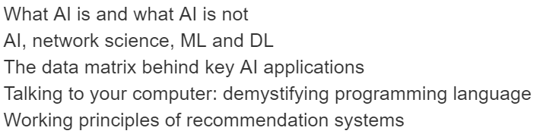
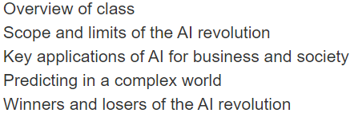
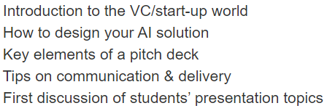
Class schedule
Write Essay
Computer Lab
Lecture 1:
AI & society
Lecture 2:
AI tools
Tutorial:
Pitching AI
Student presentations

Slide 12
Class schedule
Write Essay
Computer Lab
Lecture 1:
AI & society
Lecture 2:
AI tools
Tutorial:
Pitching AI
Student presentations

Slide 13
Class schedule
Write Essay
Computer Lab
AI solution deck
Lecture 1:
AI & society
Lecture 2:
AI tools
Tutorial:
Pitching AI
Student presentations

Slide 14
Class schedule
Write Essay
Computer Lab
AI solution deck
Lecture 1:
AI & society
Lecture 2:
AI tools
Tutorial:
Pitching AI
Student presentations

Slide 15

Etude du profil technologique de l'écosystème occitan
Lecture 1: Artificial intelligence and human society

Slide 16
AI is taking the world by storm
Notes:
Organize private trainsings, products, inve strat

Slide 17
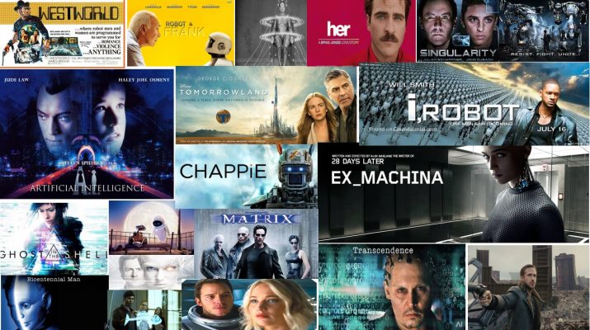
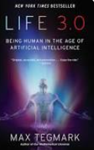
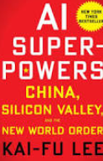
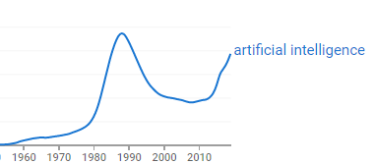
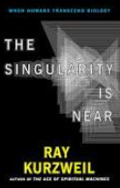

AI is everywhere – cultural products

Slide 18

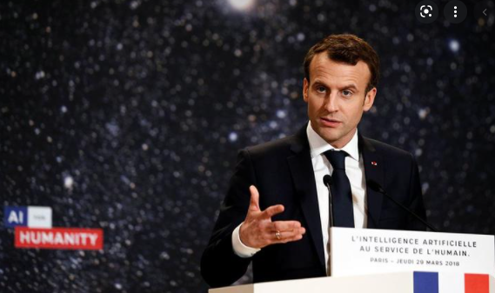
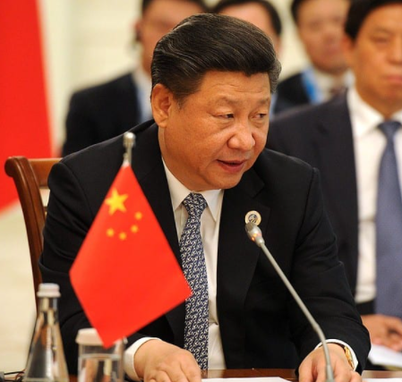
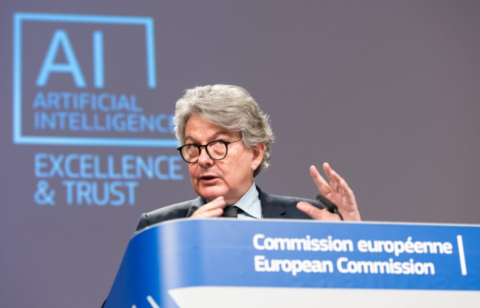
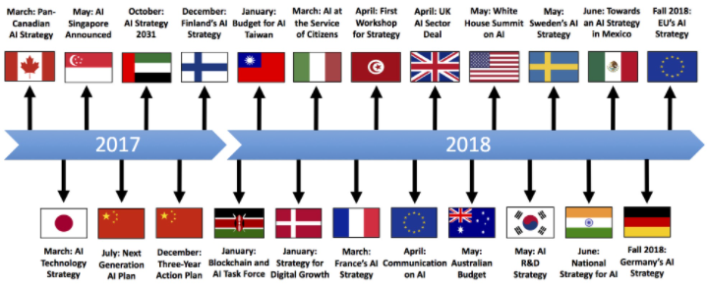
AI is everywhere – national policy
New Generation Artificial Intelligence Development Plan
(新一代人工智能发展规划)
Notes:
July 2017, China’s State Council issued the New Generation Artificial Intelligence Development Plan (AIDP)
China is pursuing a three-step plan to turn AI into a core industry for the country, one that will be worth 150 billion yuan ($22bn) by the end of 2020 to become the world's leading AI power by 2030.

Slide 19

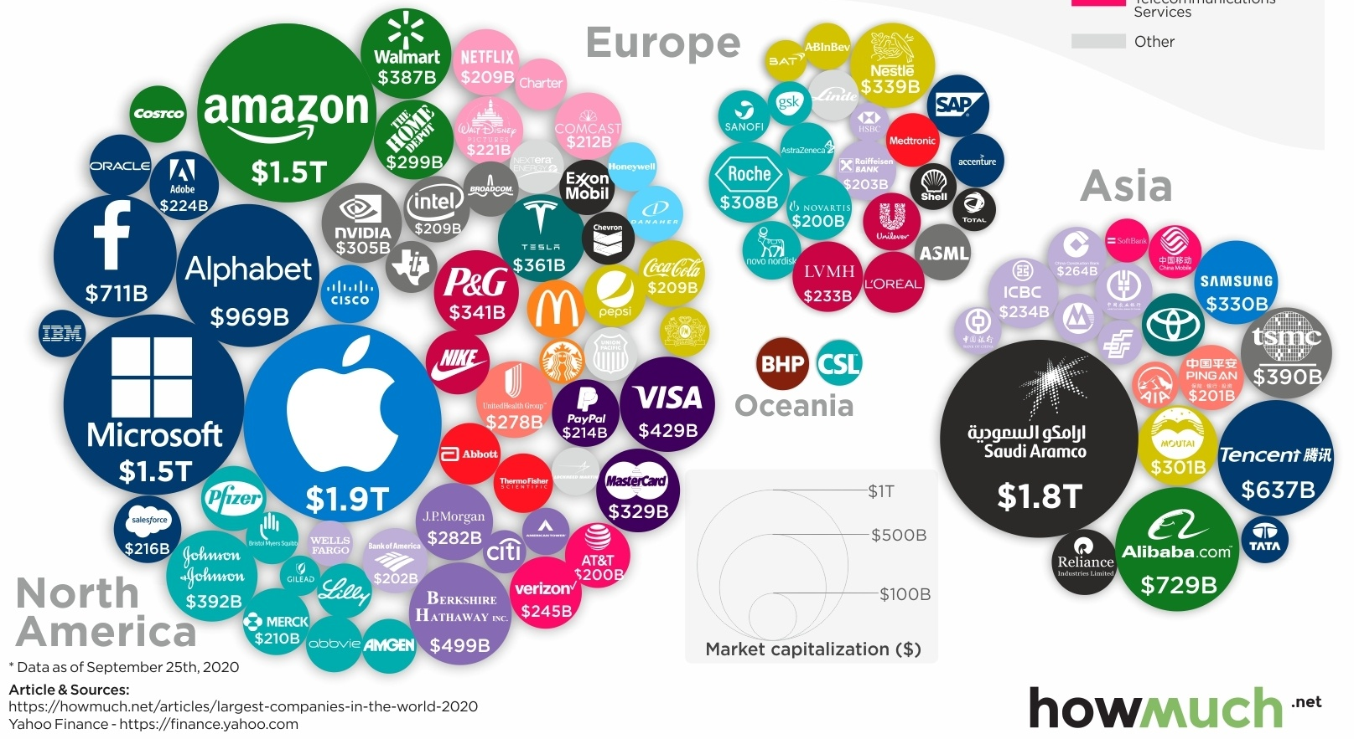
AI is disrupting the global economy
Top 100 companies by market cap
Notes:
July 2017, China’s State Council issued the New Generation Artificial Intelligence Development Plan (AIDP)

Slide 20
How intelligent did machines really become?
Notes:
Organize private trainsings, products, inve strat

Slide 21
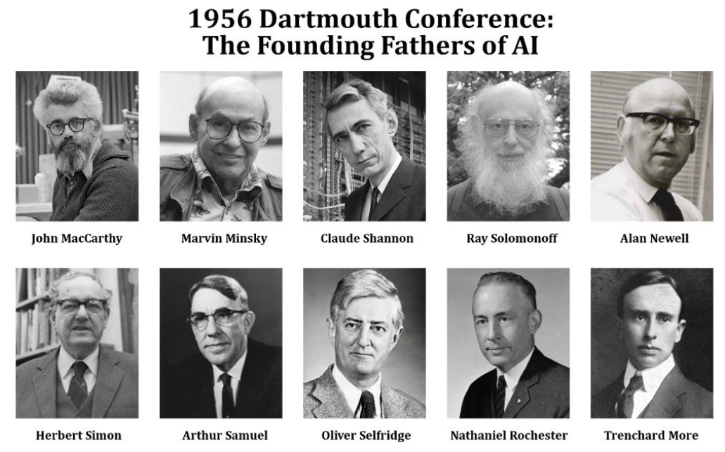
Defining AI
The ability for a machine to perform a specific task that requires human intelligence (narrow AI)

Slide 22
Defining AI
The ability for a machine to perform a specific task that requires human intelligence (narrow AI)
The ability for a machine to learn to perform any task that requires human intelligence (general AI)

Slide 23
Defining AI
The ability for a machine to perform a specific task that requires human intelligence (narrow AI)
The ability for a machine to learn to perform any task that requires human intelligence (general AI)
Above this stage is superintelligence & singularity

Slide 24
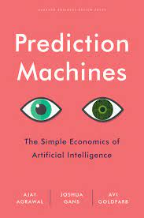
The state-of-the-art
Artificial Intelligence is all about specific AI
Notes:
Data
Computer power (GPUs) & cloud computing services

Slide 25
The state-of-the-art
Artificial Intelligence is all about specific AI
Huge transformative advances have been made in specific/narrow AI (thanks to more data, computer power & better ML/DL algorithms)
Notes:
Data
Computer power (GPUs) & cloud computing services

Slide 26
The state-of-the-art
Artificial Intelligence is all about specific AI
Huge transformative advances have been made in specific/narrow AI (thanks to more data, computer power & better ML/DL algorithms)
Advances are mainly about (internet) data-driven solutions to real-world problems
Notes:
Data
Computer power (GPUs) & cloud computing services

Slide 27
The state-of-the-art
Artificial Intelligence is all about specific AI
Huge transformative advances have been made in specific/narrow AI (thanks to more data, computer power & better ML/DL algorithms)
Advances are mainly about (internet) data-driven solutions to real-world problems
We don’t have intelligent machines - we have fast and accurate prediction machines
Notes:
Data
Computer power (GPUs) & cloud computing services

Slide 28
The state-of-the-art
Artificial Intelligence is all about specific AI
Huge transformative advances have been made in specific/narrow AI (thanks to more data, computer power & better ML/DL algorithms)
Advances are mainly about (internet) data-driven solutions to real-world problems
We don’t have intelligent machines - we have fast and accurate prediction machines
We haven’t made any significant progress in creating AGI
Notes:
Data
Computer power (GPUs) & cloud computing services

Slide 29
The state-of-the-art
Artificial Intelligence is all about specific AI
Huge transformative advances have been made in specific/narrow AI (thanks to more data, computer power & better ML/DL algorithms)
Advances are mainly about (internet) data-driven solutions to real-world problems
We don’t have intelligent machines - we have fast and accurate prediction machines
We haven’t made any significant progress in creating AGI
Singularity is likely to happen but far, far away
Notes:
Data
Computer power (GPUs) & cloud computing services

Slide 30
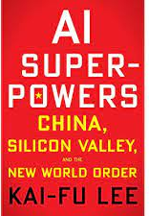
The 4 waves of AI
1: Building recommendation systems with internet data
2: Using private data for decision-making
3: Integrating prediction machines with sensors = perception AI
4: Fully-autonomous AI

Slide 31
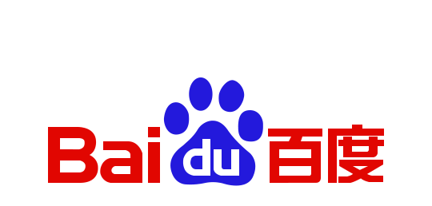



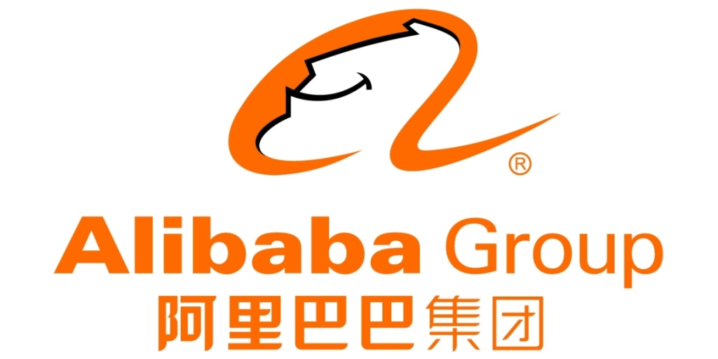

Champions of the first AI wave

Slide 32

Reinforcing Feedback Loops in AI
Google gets
more data
More customers
use Google
Google’s algorithm
gets better
Google’s offers a
better product

Slide 33
Exploiting the network structures (matrices) to make predictions

Slide 34
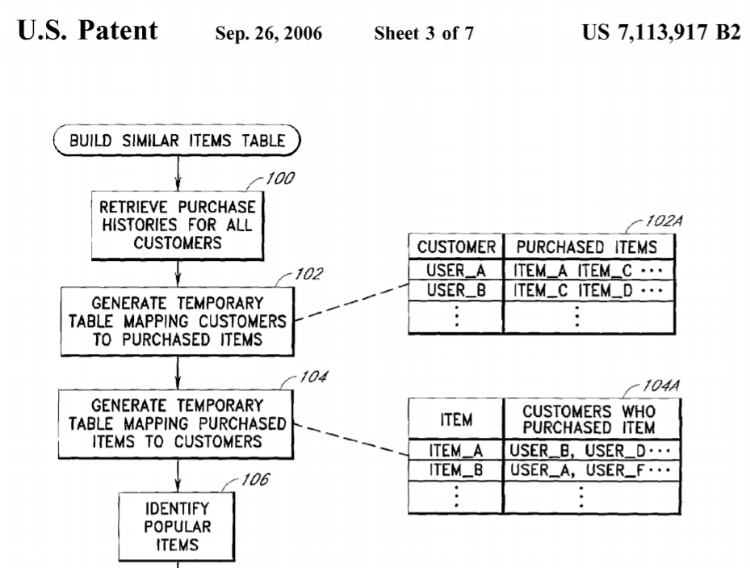
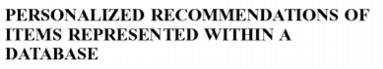
What AI can predict
Modern AI techniques are good at predicting the evolution of simple network structures
Notes:
That you can predict because you see the connections – if you don’t see them forget about it

Slide 35

EU smart specialization ($120 billion )
Complexity
High Risks
High Benefits
Low Risks
High Benefits
High Risks
Low Benefits
Low Risks
Low Benefits
Relatedness
Balland, P.A., Boschma, R., Crespo, J. and Rigby, D. (2019) Smart Specialization policy in the EU: Relatedness, Knowledge Complexity and Regional Diversification, Regional Studies

Slide 36




Private data for decision-making

Slide 37
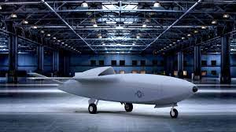
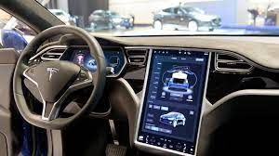
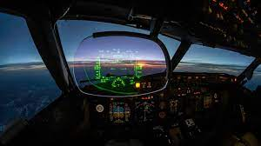
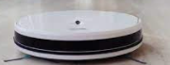
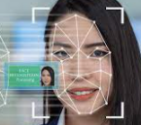
Integrating digital & physical

Slide 38
AI in healthcare
X-ray analysis, tumor detection
Fully automated clinical diagnosis
Predicting future health based on medical records & genetics
Personalized medication
Automated surgical robots (Smart Tissue Autonomous Robot)
AI-enabled dynamic prosthetics (Hugh Herr, Media Lab)

Slide 39

Leveraging complex networks
CODE
Returns are increasingly decoupled from individual efforts
MEDIA
Returns
CAPITAL
LABOR
Leverage
Notes:
Wealth comes from a position of leverage

Slide 40
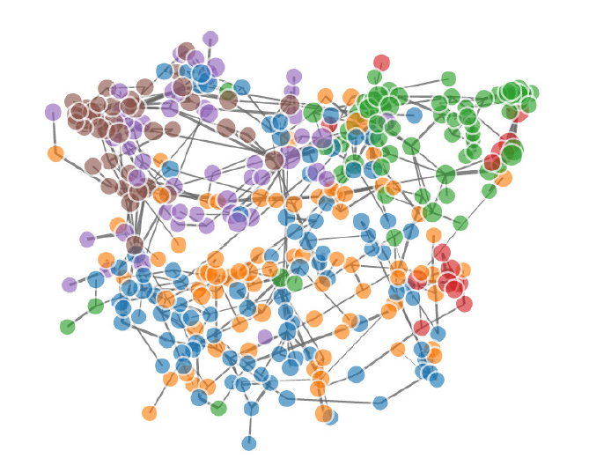
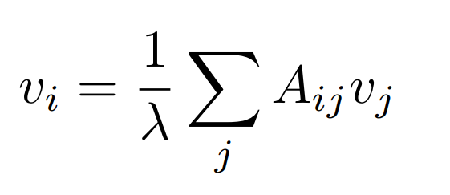
Beyond CS skills
The ability to identify business problems and re-frame them as a data science solution is as important as the programming skills needed to develop AI tools

Slide 41
The future of work
These skills are the foundation of an AI world:
- complex decision-making
- creative content
- business-technology interface
- inter-human relationships
- programming language
They are:
- hard to automate
- requires new modes of education (hard to train at scale)
- requires the re-invention of corporate culture, work ethics and lifestyle
Notes:
Understanding leveraging gives u an indication of the future of work
They require a new education system and professional habits
You might think that these skills are everywhere but they are very concentrated
AI really bad at putting together different domains

Slide 42
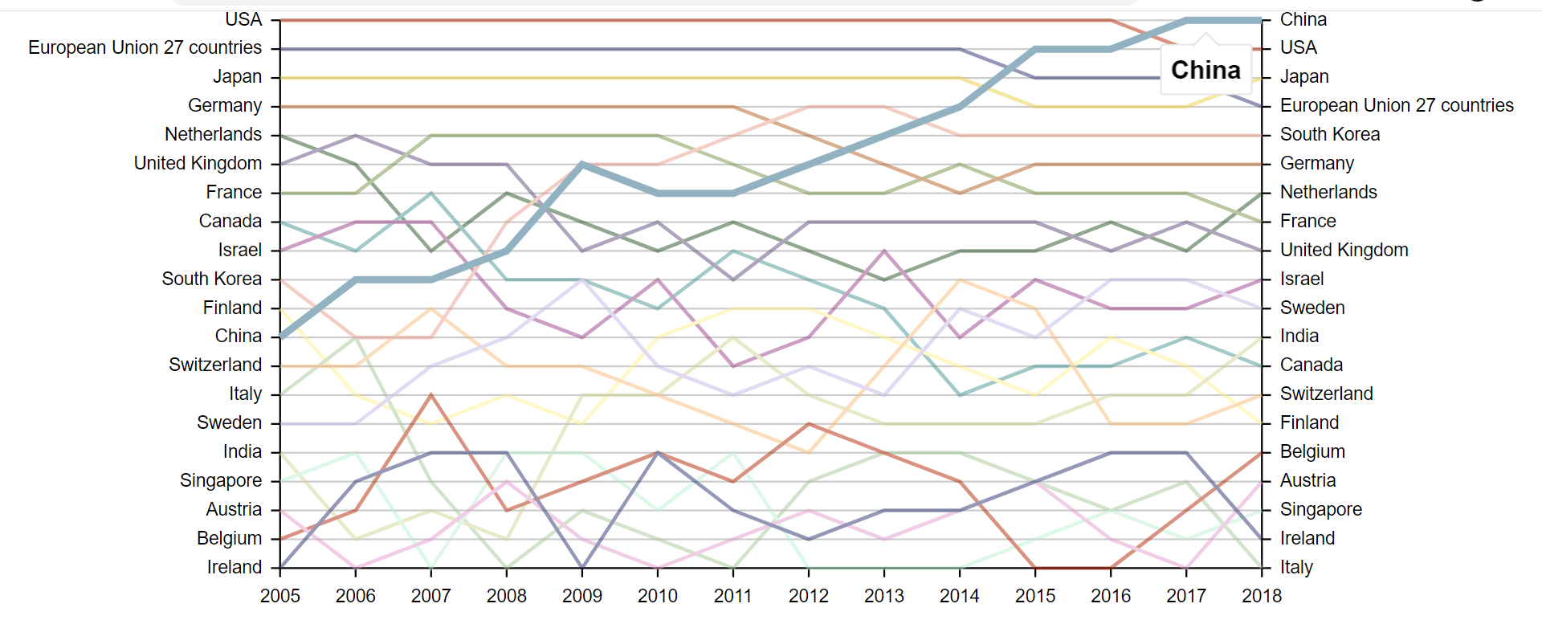
The geography of AI patents
Source: Balland (2021) – Report for DG Grow

Slide 43
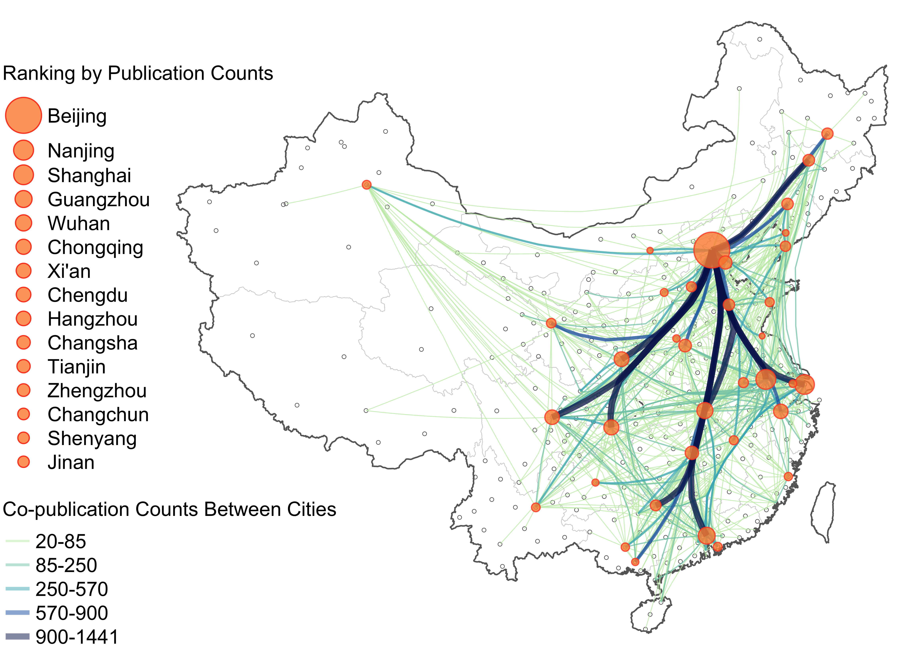
Being in the right place matters (more)
Balland et al. (2020): nature.com/articles/s41562-019-0803-3
Notes:
Complex knowledge does not travel
Individual and corporate needs this choice

Slide 44
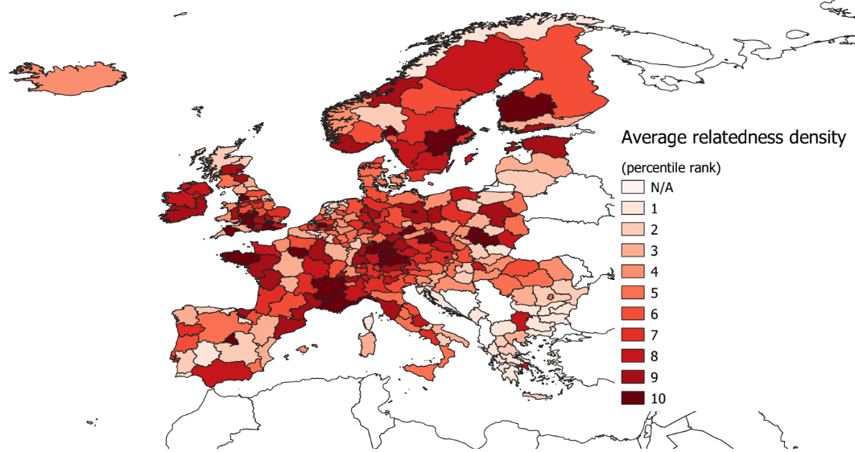
European Hubs of the industries of the future
Balland and Boschma, 2019, World Bank Report on I4.0

Slide 45




Blockchain is the other automation revolution
Crypto will:
disrupt every industry by automating transactions
enable the scaling of AI solutions (structured + interoperable data)
increase hyperconnectivity by providing trust at scale

Slide 46
When the structure of our world is too complex:
what machines can’t predict and
the strength of human wisdom

Slide 47
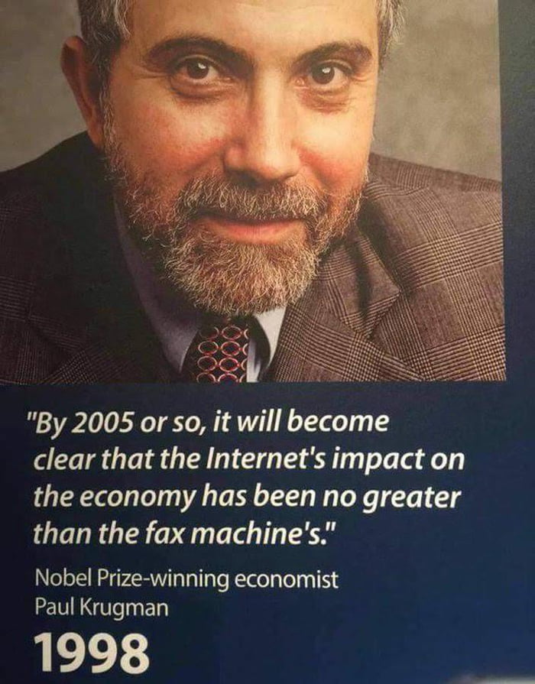

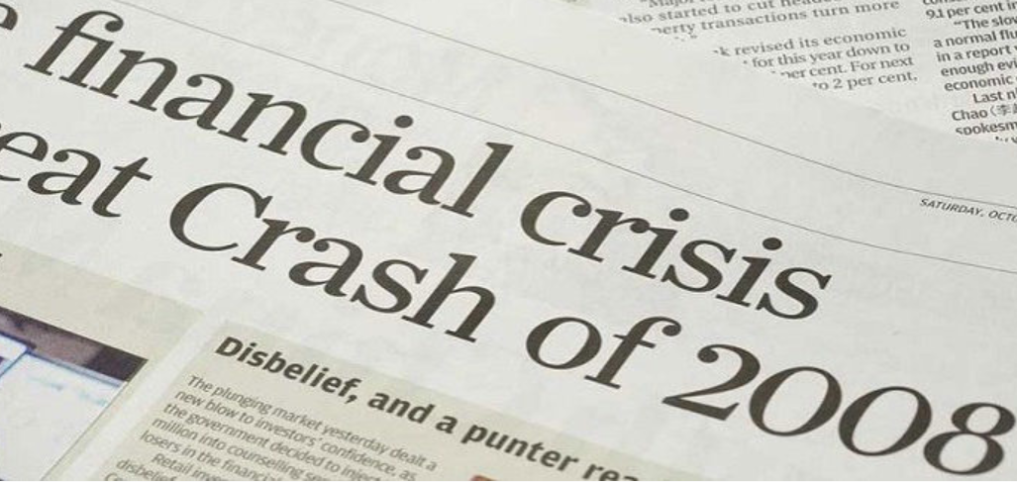
What you can not predict in a complex world
Notes:
Because of complex interactions – super hard to predict
One lesson of complexity theory: hard to predict

Slide 48
Complex systems are governed by fat tails
Most of the world
is very poor
Most humans are
similarly wealthy
Gaussian
(normal)
distribution
% of population
Very few take it all
The ultra-riches do not exist
Fat tails
Wealth
Wealth
Systemic complexity generates probability distributions with relatively high probability of extreme (positive or negative) outcomes that even the best AI can not predict
Notes:
Show the math reflection that the more we move to a complex world, the more unequal
We have been trained to think that the world works this way, changes everything

Slide 49
Complex systems & human wisdom
Complex systems heuristics
→ Leverage, optionality & redundancy
→ Exposed to upside and protect from downside
→ Risks/rewards come from multiplicative systemic effects
Evolutionary collective wisdom
→ Those who used it survived
→ No science – error and feedback evolutionary loops
→ You don’t know you are using it
Notes:
Understanding leveraging gives u an indication of the future of work
They require a new education system and professional habits
You might think that these skills are everywhere but they are very concentrated
AI really bad at putting together different domains

Slide 50

Merci x Thanks x 谢谢
@pa_balland
www.paballand.com

